Slide 1



Communication and In-group Working Skills (cont.)

Slide 2

CHAPTER OUTLINE
3. The Psychology of Groups

Slide 3

LEARNING OBJECTIVES
Review the evidence that suggests humans have a fundamental need to belong to groups.
Compare the sociometer model of self-esteem to a more traditional view of self-esteem.
Describe how groups change over time.
Apply the theory of groupthink to a well-known decision-making group

Slide 4

6. The Psychology of Groups
Most of us live out our lives in groups, and these groups have a profound impact on our thoughts, feelings, and actions.
Notes:
Profound /prəˈfaʊnd/ felt or experienced very strongly or in an extreme way

Slide 5


“I must be myself. I will not hide my tastes or aversions . . . . I will seek my own”. People can live separate and apart from others!
What is the psychological significance of groups?
They join with others because groups meet their psychological and social needs.

Slide 6

The Need to Belong
87.3% of Americans reported that they lived with other people such as family members, partners, and roommates (Davis & Smith, 2007).
50% to 80%, reported regularly doing things in groups, such as attending a sports event together, visiting one another for the evening, sharing a meal together, or going out as a group to see a movie (Putnam, 2000).

Slide 7
Affiliation in Groups
Groups provide members with information, assistance, and social support.
Leon Festinger’s theory of social comparison (1950, 1954) suggested that in many cases people join with others to evaluate the accuracy of their personal beliefs and attitudes.
Notes:
Affiliation /əˌfɪl.iˈeɪ.ʃən/ Affiliate (v) to cause a group to become part of or form a close relationship with another, usually larger, group, or organization

Slide 8

Identity and Membership
Groups help us answer the existentially significant question, “Who am I?”
People are defined not only by their traits, preferences, interests, likes, and dislikes, but also by their friendships, social roles, family connections, and group memberships.
The self is not just a “me,” but also a “we.”

Slide 9
Evolutionary Advantages of Group Living
Groups may be humans’ most useful invention, for they provide us with the means to reach goals that would elude us if we remained alone.
“People become dependent on one another for the satisfaction of their needs” (Theory of social integration, Moreland).
Notes:
Elude /iˈluːd/ If something that you want eludes you, you do not succeed in achieving it LẢNG TRÁNH, TRỐN TRÁNH, VƯỢT QUÁ KHẢ NĂNG/KIẾN THỨC

Slide 10

Motivation and Performance
Social Facilitation in Groups: Do people perform more effectively when alone or when part of a group?
Social Loafing: Groups usually outperform individuals. “Many hands make light the work” (Littlepage, 1991; Steiner, 1972)
But it can be a problem!
One way to overcome it is by recognizing that each group member has an important part to play in the success of the group.

Slide 11
Teamwork
Researchers have identified two key ingredients to effective teamwork:
a shared mental representation of the task
and group unity.
Teams improve their performance over time as they develop a shared understanding of the team and the tasks they are attempting.

Slide 12
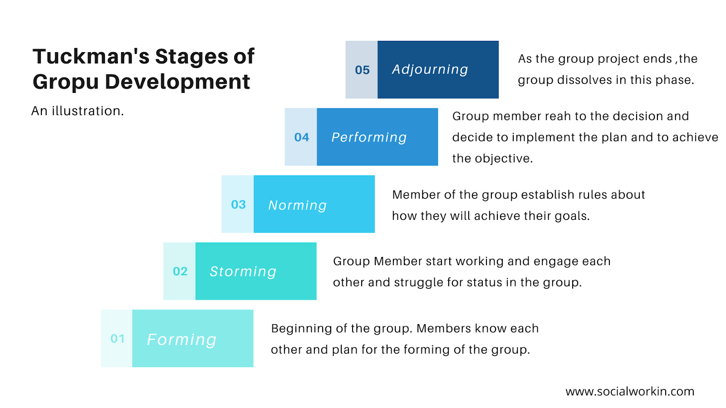
Tuckman’s Group Development Stages
Notes:
Mô hình Tuckman: mô hình đc sử dụng phổ biến
Forming: hình thành, các cá tính chưa bộc lộ
Storming: bộc lộ khác biệt, đặt ra các rào cản, vđề cần gq
Norming: đặt ra rules để compromise những khác biệt
Performing: gđ khiến cho cv chạy, diễn ra thuận lợi, mn học đc cách làm việc cùng nhau
Adjourning: gđ tan rã, vd: nhiệm vụ hoàn thành, kết thúc

Slide 13







Tuckman’s Group Development Stages
adjourning
performing
norming
storming
forming
Notes:
adjourn/əˈdʒɜːrn/: to stop a meeting or an official process, especially a trial, for a period of time

Slide 14

Making Decisions in Groups
For groups can draw on more resources than can a lone individual.
More ideas and possible solutions by discussing the problem.
A group’s decision will be superior to an individual’s decision.
However, groups do not always make good decisions

Slide 15
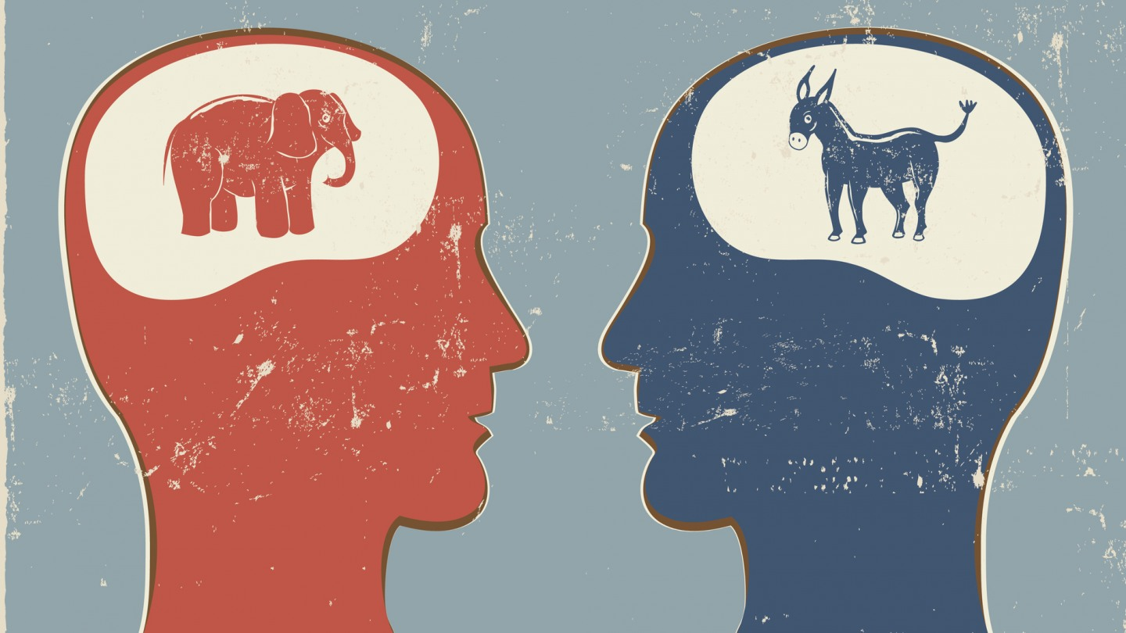
Group Polarization
Common sense notions suggest that groups exert a moderating, subduing effect on their members.
Many groups shift toward more extreme decisions rather than less extreme decisions after group interaction
Let’s say you are part of a group assigned to make a presentation. One of the group members suggests showing a short video that, although amusing, includes some provocative images. Even though initially you think the clip is inappropriate, you begin to change your mind as the group discusses the idea.
Notes:
Polarization /ˌpoʊ.lɚ.əˈzeɪ.ʃən/ the act of dividing something, especially something that contains different people or opinions, into two completely opposing groups
Exert /ɪɡˈzɝːt/: to use something such as authority, power, influence, etc. in order to make something happen
Subdue /səbˈduː/: to reduce the force of something, or to prevent something from existing or developing

Slide 16

Common Knowledge Effect or Shared Information Bias
Researchers have studied this bias using the hidden profile task. On such tasks, information known to many of the group members suggests that one alternative, say Option A, is best.
However, Option B is definitely the better choice, but all the facts that support Option B are only known to individual groups members - they are not common knowledge in the group.
As a result, the group will likely spend most of its time reviewing the factors that favor Option A, and never discover any of its drawbacks.
In consequence, groups often perform poorly when working on problems with nonobvious solutions that can only be identified by extensive information sharing.

Slide 17
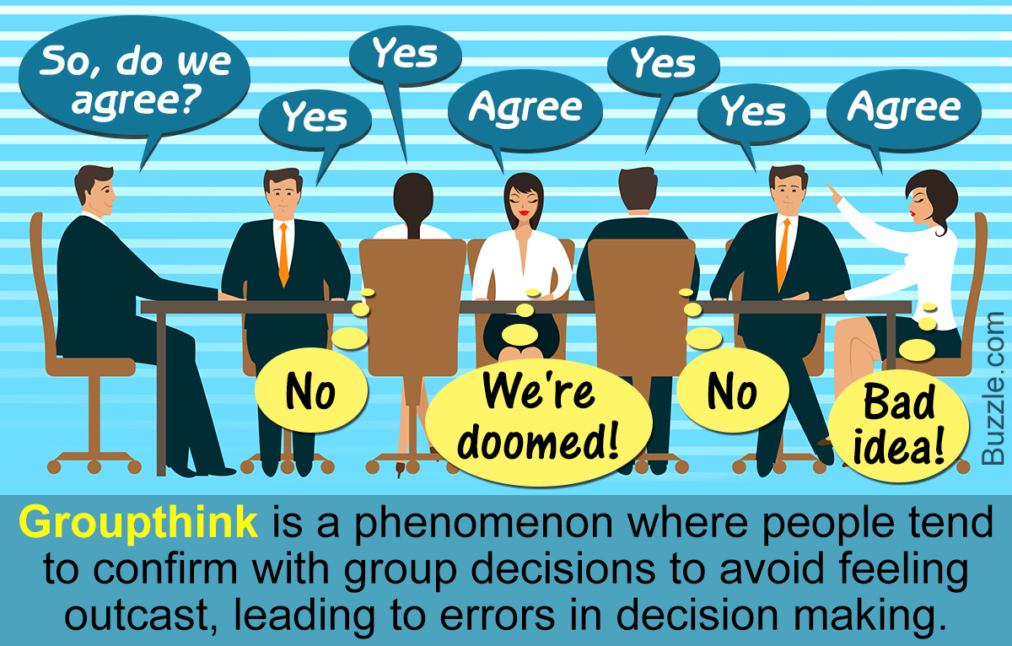

Slide 18
Groupthink
GROUPS SOMETIMES MAKE SPECTACULARLY BAD DECISIONS.
04 GROUP-LEVEL FACTORS THAT COMBINE TO CAUSE GROUPTHINK:
Cohesion
Isolation
Biased leadership
Decisional stress

Slide 19
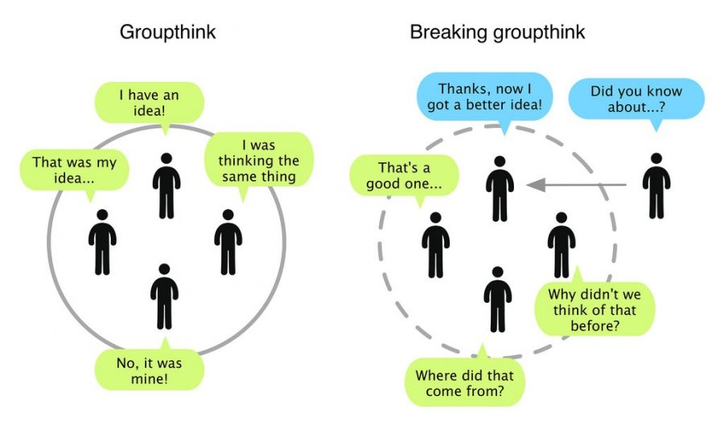

Slide 20
You and Your Groups
1. What are the advantages and disadvantages of sociality? Why do people often join groups?
2. Is self-esteem shaped by your personality qualities or by the value and qualities of groups to which you belong?
3. In what ways does membership in a group change a person’s self-concept and social identity?
Discussion Questions

Slide 21
You and Your Groups
4. What steps would you take if you were to base a self-esteem enrichment program in schools on the sociometer model of self-worth?
5. What are the key ingredients to transforming a working group into a true team?
6. Have you ever been part of a group that made a poor decision and, if so, were any of the symptoms of groupthink present in your group?
Discussion Questions

Slide 22


